Slide 1
How To Model Experience Replay, Batch Learning and Target Networks

Slide 2
Deep Q-learning
Deep Q-learning is simply a matter of replacing a lookup table with a neural network
Although Deep Q-learning allows handling very large state spaces and complicated non-linear environments, these benefits come at a substantial cost.
stability issues and three often-used techniques to mitigate these issues: experience replay, batch learning and target networks.

Slide 3

Update function and loss function
Colloquial update function for (vanilla) Q-learning.
Mean-squared error loss function for deep Q-learning.

Slide 4
Stability of (deep) Q-learning
To some degree, stability is a problem in every learning task.
vanilla Q-learning is fairly stable.
When observing the rewards corresponding to some state-action pair (s,a), only the corresponding Q-value Q(s,a) is updated. All other Q-values in the lookup table remain the same.

Slide 5
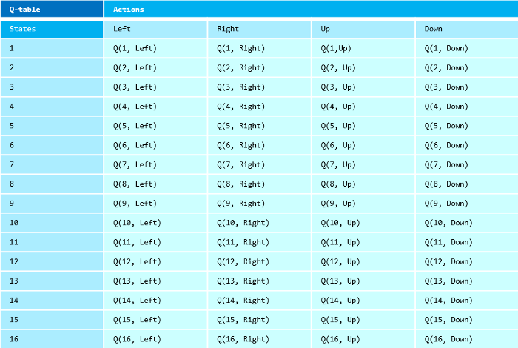
Example of a Q-table. Updates are performed on Q-values pertaining individual state-action pairs, resulting in a stable representation.

Slide 6
Stability of (deep) Q-learning
In contrast, a Q-network can be seen as a parameterized function f_θ:s →[Q(s,a)]_a∈A, mapping a state to a vector of Q-values.
The key difference here is that a single update changes all Q-values, for every state-action pair.
The implications are quite far-reaching, somewhat exacerbated by the non-linear representation that is a neural network (sensitivity to outliers etc.)
Even for seemingly straightforward problems, deep Q-learning is often affected by stability issues.

Slide 7
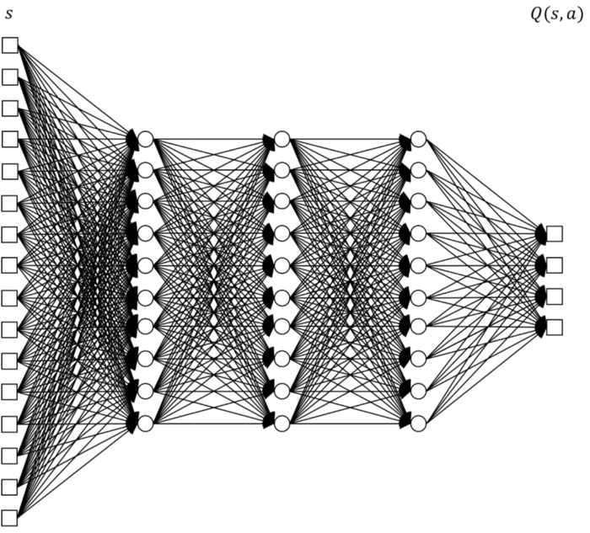
Example of a Q-network. A single update affects Q-values for all state-action pairs, as the same network is used for all inputs

Slide 8
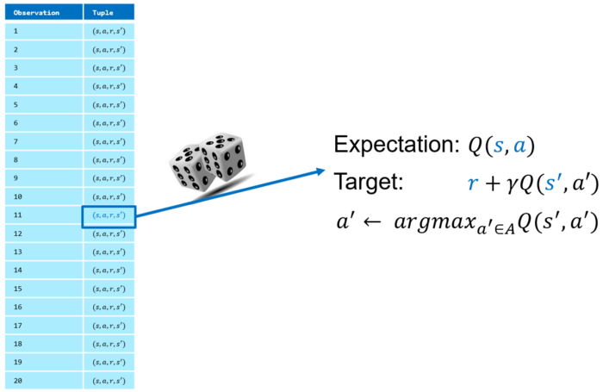
Experience replay
Experience replay randomly samples an observation (an s,a,r,s’ tuple) from the replay buffer. Expectation and target are determined by plugging s and s’ into the Q-network

Slide 9
Stability of (deep) Q-learning
Reinforcement learning entails making sequential decisions.
This often means that subsequent states are closely related (e.g., a single step in a maze, a one-day update in stock price)
As a result, sequential observations tend to be highly correlated, which may lead to overfitting the network (e.g., in a suboptimal area of a maze).

Slide 10
Stability of (deep) Q-learning
However, even though experience is gained sequentially, there is no reason learning should follow the same sequence.
Experience replay separates both processes by creating a replay buffer with past observations.
Specifically, the replay buffer stores each s,a,r,s’ tuple we encounter.
Note that the corresponding Q-values are not stored; we determine them at the moment we sample the observation for updating purposes.

Slide 11
Learning Procedure
Sample random s,a,r,s’ tuple from replay buffer.
Feed s into Q-network to obtain Q_t(s,a), using stored action a.
Feed s’ into Q-network to obtain Q_t+1(s’,a*), where a*∈A is the optimal action (according to the prevailing Q-values) in state s’
Recall that Q-learning is off-policy, so we don’t use the actual trajectory.
Use the difference between Q_t(s,a) and r_t+Q_t+1(s’,a*) to compute the loss needed for updating the network.

Slide 12
"""Experience replay implementation"""
# Initialize replay buffer
replay_buffer = []
# Experience collection phase
# Set state
state = next_state
# Determine action (epsilon_greedy)
if epsilon<= 0.05:
# Select random action
action = np.random.choice(action_dim)
else:
# Select action with highest q-value
action = np.argmax(q_values[0])
# Compute and store reward
reward = get_reward(state, action)
# Determine next state
next_state = get_state(state, action)
# Store observation in replay buffer
observation = (state, action, reward, next_state)
replay_buffer.append(observation)
# Learning phase
# Select random sample from replay buffer
if len(replay_buffer) >= min_buffer_size:
observations = random.choices(replay_buffer, k=1)

Slide 13
Stability of (deep) Q-learning
Storing every past observation and sampling completely at random might not be ideal. Indeed, the procedure could be refined.
With prioritized replay we more often sample experiences from which we expect to learn much.
Another common technique is to update the replay buffer, deleting older observations.
After all, you don’t want to keep dwelling on past observations from regions of the state space that we never should have visited in the first place.

Slide 14
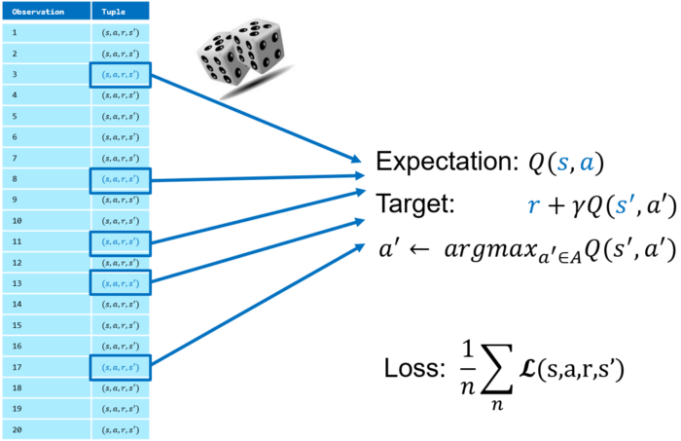
Batch learning
perform all training iterations and use the complete batch of observations to fit the Q-network with a single update.
Although such a batch would be representative indeed, all observations would be made with our initial (likely very poor) policy, such that we never learn the Q-values corresponding to a good policy.
Batch learning samples multiple observations for a single network update, leading to more representative losses and more stable update

Slide 15
Batch learning
Thus, large batches are not very useful either. We want to intertwine observing and updating to gradually improve our policy.
This does not mean we have to update every observation though.
The obvious compromise are mini-batches, meaning that we frequently update our network with a relatively small number of observations.
Combined with experience replay, this is a powerful technique to get stable updates based on a vast pool of previous observations.

Slide 16
"""Batch learning implementation"""
no_observations = 100
mini_batch_size = 10
loss_value = 0
if len(replay_buffer) >= no_observations and
i % update_frequency == 0:
# Randomly sample k observations from buffer
observations = random.choices(replay_buffer, k=mini_batch_size)
# Loop over sampled observations
for observation in observations:
# Determine Q-value at time t
q_values = q_network(state)
expected_value = q_values[0, action]
# Determine Q-value at time t+1
next_q_values = tf.stop_gradient(q_network(next_state))
next_action = np.argmax(next_q_values[0])
next_q_value = next_q_values[0, next_action]
# Add direct reward to obtain target value
target_value = reward + (gamma * next_q_value)
# Compute loss value
loss_value += mse_loss(expected_value, target_value)
# Compute mean loss value
loss_value /= batch_size

Slide 17
Two Important Policies of RL
On-policy reinforcement learning
Off-policy reinforcement learning

Slide 18
On-policy reinforcement learning
SARSA (state-action-reward-state-action) is an on-policy reinforcement learning algorithm that estimates the value of the policy being followed.
In this algorithm, the agent grasps the optimal policy and uses the same to act.
The policy that is used for updating and the policy used for acting is the same, unlike in Q-learning. This is an example of on-policy learning.

Slide 19
On-policy reinforcement learning
An experience in SARSA is of the form ⟨S,A,R,S’, A’ ⟩, which means that
current state S,
current action A,
reward R, and
new state S’,
future action A’.
This provides a new experience to update from
Q(S,A) to R+γQ(S’,A’).

Slide 20
Off-policy reinforcement learning
In Q-Learning, the agent learns optimal policy with the help of a greedy policy and behaves using policies of other agents.
Q-learning is called off-policy because the updated policy is different from the behavior policy, so Q-Learning is off-policy.
In other words, it estimates the reward for future actions and appends a value to the new state without actually following any greedy policy.

Slide 21
Thank U
https://towardsdatascience.com/how-to-model-experience-replay-batch-learning-and-target-networks-c1350db93172

